Slide 1
Assessing Campus Climate for Gallaudet University Employees 2025:
Employee Satisfaction Survey
GALLAUDET UNIVERSITY
Office of Institutional Research
Notes:
Great to see you here today.
Campus Climate for employees is an extremely important topic.
The format will be :
1) 40 minutes of presentation: me and Caroline
2) 20 minutes of Q and A and discussion

Slide 2
Overview
Overview of the 2025 Employee Satisfaction Survey
Background of Employee Satisfaction Survey (ESS)
Introduction to the ESS
Results of 2025 ESS
Comparison: 2019 and 2025 EES Results
Next Steps
Notes:
In higher education, camps climate can mean many different things:
Diversity, sexual harassment, work environment.
Today, we will focus on the work environment, specifically employees’ satisfaction using the Employee Satisfaction Survey from Ruffalo Noel Levitz.
We will talk about the Employee Satisfaction Survey, the results, comparison of the last survey administration, and next steps.

Slide 3
Background of Employee Satisfaction Survey (ESS)
SECTION 1

Slide 4
ESS Background*
Background of Employee Satisfaction Survey (ESS)
Administered
annually
Administered annually to establish benchmark
Administered biannually to allow time for institutional changes
2007 to 2014
Spring
2015
Spring
2016
Spring
2017
Spring
2019
Spring2021
Spring2023
Spring
2025
Gallaudet
Campus
Climate
Survey
Ruffalo Noel Levitz Employee Satisfaction Survey
Postponed due to COVID
RNL ESS refreshed
Postponed due to Operational Transforma-tional Work
* All climate survey reports are posted at OIR website at:
https://gallaudet.edu/institutional-research-effectiveness/institutional-research/reports-and-surveys/gallaudet-university-campus-climate-survey/
Notes:
Gallaudet initially had a homegrown survey starting in 2007. It evolved over time to assess areas that were important to the University.
It was administered annually from 2007 through 2014.
In 2015, Gallaudet decided to move away from a homegrown survey to the Ruffalo Noel-Levitz survey because
Gallaudet and higher education concerns broadened
it is the same survey for all employees
allows for peer comparisons
provides multiple kinds of analyses on different areas (campus culture and policies, institutional goals, and work experience)

Slide 5
Introduction to the Employee Satisfaction Survey (ESS)
SECTION 2

Slide 6
2025 ESS Survey
Introduction to the Employee Satisfaction Survey (ESS)
87 employee climate-related questions
84 items
3 open-ended questions
Employee Satisfaction Survey Areas
Overall (2 items, 2 open-ended)
Campus culture and policies (38 items)
Institutional Goals (12 items, 1 open-ended)
Employee Experience (32 items)

Slide 7
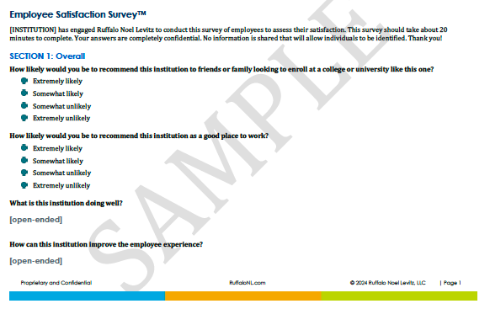
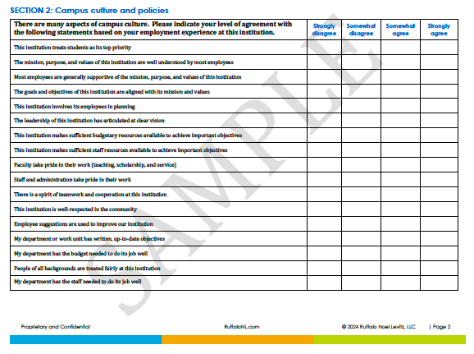
ESS Survey
Introduction to the Employee Satisfaction Survey (ESS)

Slide 8
Results of 2025 Employee Satisfaction Survey (ESS)
SECTION 3

Slide 9
2025 ESS Responses
Results of 2025 Employee Satisfaction Survey (ESS)
892 faculty, staff and administrators
407 regular-status employee responded (46%); partially or complete
Percentage of Respondents by Role:
Employee Role | N | Respondents* | % of Total ESS Responses - 2025
Faculty (regular status) | 156 | 83 | 53%
Staff (e.g., regular status) and Admin (e.g., C-suite, School Directors, Dean, Directors) | 736 | 209 | 28%
Unknown | - | 115 | n/a
*Respondents' numbers are based on self-disclosed employee type and are an estimate given that the survey was completely anonymous.

Slide 10
2025 ESS Responses
Results of 2025 Employee Satisfaction Survey (ESS)
Breakdown of respondents by employee type
Employee Role |  | N ESS Responses |  | % of Total ESS Responses - 2025
Faculty |  | 83 |  | 20%
All Staff |  | 180 |  | 44%
Exempt Staff | Non-Exempt Staff | 137 | 43 | 76% | 24%
Administrator |  | 29 |  | 7%
Unknown |  | 115 |  | 28%
Total Employees |  | 407 |  | 100%

Slide 11
Section I. Overall
Results of 2025 Employee Satisfaction Survey (ESS)
How likely would you be to recommend this institution to friends or family looking into enroll at a college or university like this one?
How likely are you to recommend this institution as a good place to work?

Slide 12
Section I. Overall
Results of 2025 Employee Satisfaction Survey (ESS)

Slide 13
Section I. Overall
Results of 2025 Employee Satisfaction Survey (ESS)

Slide 14
Section I. Overall
Results of 2025 Employee Satisfaction Survey (ESS)
Open-ended results for what is this institution doing well?

Slide 15
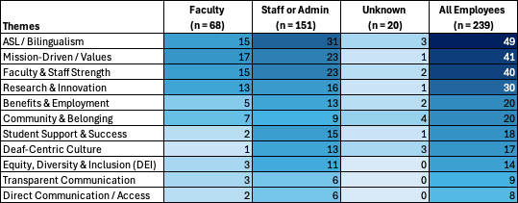
Section I. Overall
Results of 2025 Employee Satisfaction Survey (ESS)
Heatmap of What Gallaudet is Doing Well: Thematic Highlights from Employees

Slide 16
Section I. Overall
Results of 2025 Employee Satisfaction Survey (ESS)
What is Gallaudet Doing Well: Top 3 Thematic Highlights from Employees Further Explained

Slide 17
Results of 2025 Employee Satisfaction Survey (ESS)
What is Gallaudet Doing Well: Top 3 Thematic Highlights from Employees
ASL/Bilingualism: Gallaudet remains a beacon for ASL and bilingual education
  “Access to ASL on different levels and value of human diversity.”
  “It values the use of ASL and creating a bilingual learning/work environment.”
  “Bilingual mission, support of research, competitive salary.”
  “Full bilingual access for everyone in ASL and written English.”

Slide 18
Results of 2025 Employee Satisfaction Survey (ESS)
What is Gallaudet Doing Well: Top 3 Thematic Highlights from Employees
Mission-Driven / Values: Employees deeply connect to the educational mission and student success.
  “Attaining academic excellence for the Deaf globally.”
  “Clear mission and goals; focus on students and equity.”
  “Commitment to both academic excellence and diversity.”
  “Everyone is united in our mission to educate deaf and hard of hearing people. If it weren’t for this, many employees (including myself) would leave.”

Slide 19
Results of 2025 Employee Satisfaction Survey (ESS)
What is Gallaudet Doing Well: Top 3 Thematic Highlights from Employees
Faculty & Staff Strength: Passionate and supportive teams make a difference
  “Faculty are passionate and invested in the advancement of Deaf/HH/DB people.”
  “Strong teamwork and respect across programs.”
  “Faculty continue to teach in very adverse conditions, demonstrating commitment to students and their jobs.”
  “My colleagues are supportive, and there is a strong family-oriented culture.”

Slide 20
Section I. Overall
Results of 2025 Employee Satisfaction Survey (ESS)
Open-ended results for how can this institution improve the employee experience?

Slide 21
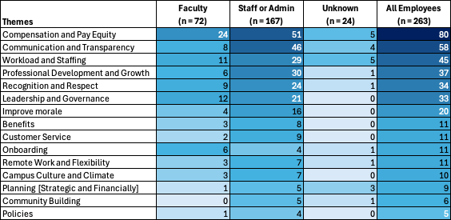
Section I. Overall
Results of 2025 Employee Satisfaction Survey (ESS)
Heatmap of How Can Gallaudet Improve: Thematic Highlights from Employees

Slide 22
Section I. Overall
Results of 2025 Employee Satisfaction Survey (ESS)
How can Gallaudet Improve: Top 3 Thematic Highlights from Employees Further Explained

Slide 23
Results of 2025 Employee Satisfaction Survey (ESS)
How can Gallaudet Improve: Top 3 Thematic Highlights from Employees
Compensation and Pay Equity: Employees strongly stated concerns about salary fairness and financial stress.
  “Level the salaries to the faculty average in Washington DC”
  “By raising salaries (not for C-level members)”
  ““Consistent, annual cost of living adjustments”
  “Increased pay and regular raises [to] align with DMV living costs”

Slide 24
Results of 2025 Employee Satisfaction Survey (ESS)
How can Gallaudet Improve: Top 3 Thematic Highlights from Employees
Communication and Transparency: Employees seek more clarity, consistency, and openness from leadership.
  “Administration need to be more transparent and improve communication with employees”
  “Transparency of the executive directors’ activities and expenses is sorely missing”
  “There needs to be better communication among the executive team leaders on overlapping systems, resources, and priorities to reduce redundancy”
  “Transparency is talked about as being a value for the administrators; however, employees depend on one another to learn about what is happening at Gallaudet (and sometimes have to turn outside of the university for factual information)”

Slide 25
Results of 2025 Employee Satisfaction Survey (ESS)
How can Gallaudet Improve: Top 3 Thematic Highlights from Employees
Workload and Staffing: Faculty and staff feel overwhelmed by responsibilities and ask for better staffing support.
  “We are overworked and under-resourced. We feel the difference between how things are and how they used to be.”
  “…the majority of employees have too many tasks and not enough time to complete. This is leading to overwork, burnout, and working outside of usual hours”
  “Employees are starting to do two or more people’s jobs. Programs and services will eventually need to cut back or scale down to a manageable level.”
  We are needing to ‘go lean’, which is fine – however it does not mean “Do More with Less” and adding more work to already overworked staff;”

Slide 26
Section II. Campus Culture and Policies
Results of 2025 Employee Satisfaction Survey (ESS)
How well do our employees agree with the Campus Culture and Policies statements?
Likert Scale of 1 = strongly disagree and 4 = strongly agree

Slide 27
Section II. Campus Culture and Policies
Results of 2025 Employee Satisfaction Survey (ESS)
STRENGTHS (Ordered by Highest Agreement) | CHALLENGES (Ordered by Highest Disagreement)
My supervisor/academic department head pays attention to what I have to say | There is effective lines of communication between departments
My manager/academic department head communicates openly and honestly with me | University leadership is accessible and receptive to input
My job responsibilities are communicated clearly with me | There is good communication between leadership and faculty, staff and administration at this institution
My supervisor/academic department head helps me improve my job performance | Transparent and informed communication is practiced consistently throughout the university community
My colleagues welcome opinions different from my own | Information flows upward and is recognized at higher levels of the administration

Slide 28
Section III. Institutional Goals
Results of 2025 Employee Satisfaction Survey (ESS)
How important are each of these institutional goals?
Likert Scale of 0-3 = not important,
4-5 = somewhat important, and
7-10 = critical

Slide 29
Section III. Institutional Goals
Results of 2025 Employee Satisfaction Survey (ESS)
Most Important
Retain more of its current students to graduation
Maintain or improve the financial health of the institution
Increase enrollment of new students
Improve employee morale
Improve the academic ability of entering classes

Slide 30
Section IV. Employee Experience
Results of 2025 Employee Satisfaction Survey (ESS)
Rate your overall satisfaction with your experience at this institution.
How likely would you be to continue to work at this institution if you were offered the same job at another institution?

Slide 31
Section IV. Employee Experience

Slide 32
Section IV. Employee Experience

Slide 33
Section IV. Employee Experience
What is the relationship between employees’ job satisfaction and likelihood of continuing to work at Gallaudet if they were offered the same job at another institution?

Slide 34
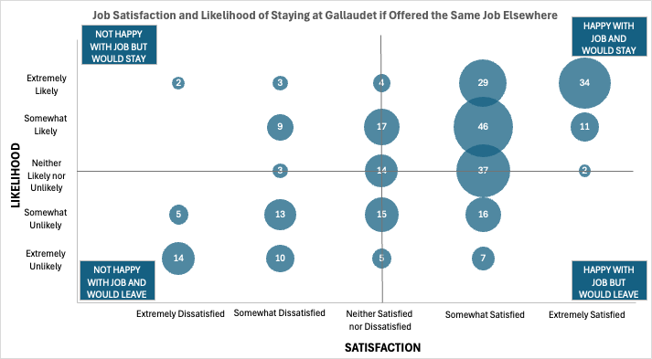

Slide 35
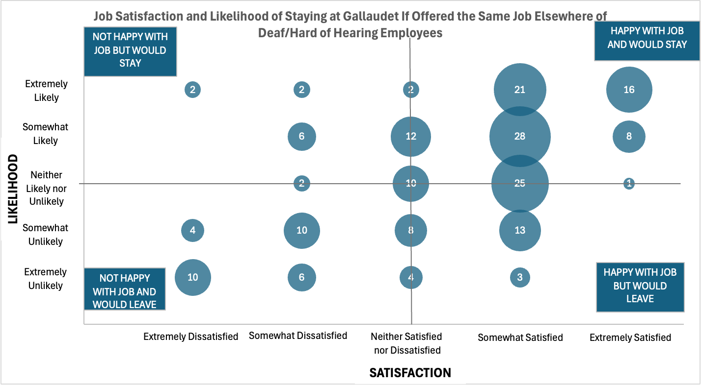

Slide 36
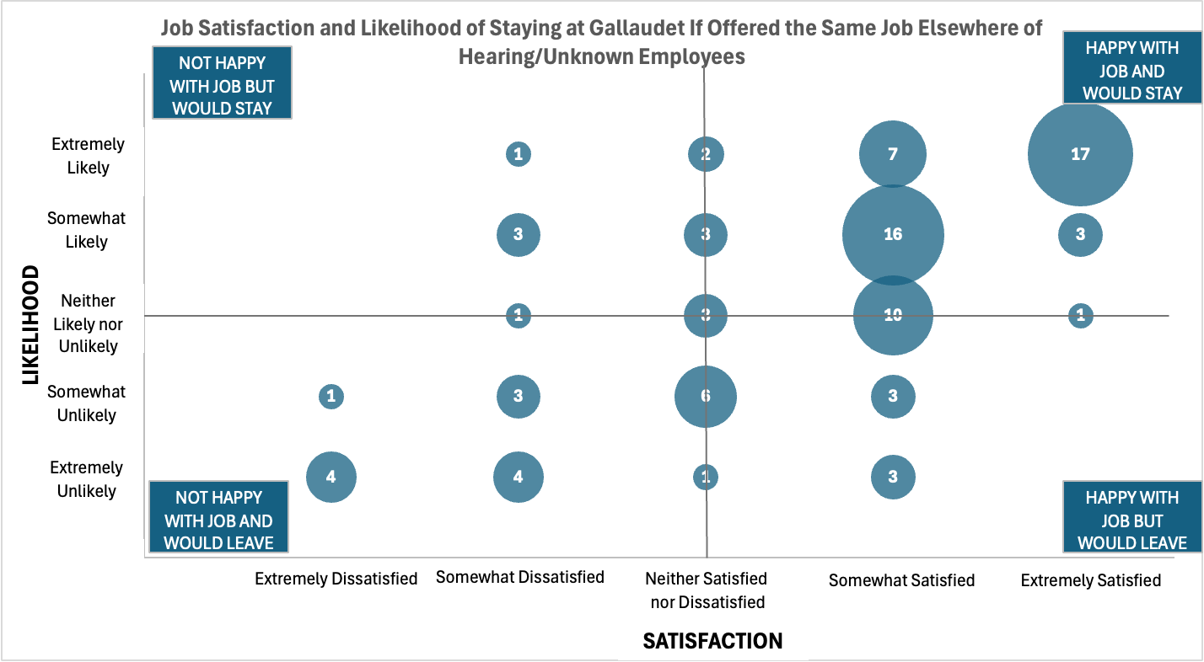

Slide 37
Section IV. Employee Experience
Key takeaways:
41% of the employees are satisfied with their job and likely to continue at Gallaudet while 14% are not satisfied with their job and unlikely to continue at Gallaudet.
Differences were not significant by hearing status.
Differences were not significant by employee type (faculty and staff/admin)

Slide 38
Section IV. Employee Experience
Results of 2025 Employee Satisfaction Survey (ESS)
How well do our employees agree with the Employee Experience statements?
Likert Scale of 1 = strongly disagree and 4 = strongly agree

Slide 39
Section IV. Employee Experience
Results of 2025 Employee Satisfaction Survey (ESS)
STRENGTHS (Ordered by Highest Agreement) | CHALLENGES (Ordered by Highest Disagreement)
I consider myself to be highly engaged at work | I am paid fairly for the work I do
The work I do is valuable to the institution | I have opportunities for advancement
In my current role, I am motivated to do my best work | My job is secure at this institution
My role (title) and responsibilities are a good fit for my education and experience level | If I do great work, I know it will be recognized
The work I do is appreciated by my supervisor/academic department head | My workload is reasonable
The employee benefits available to me are valuable | This institution encourages a healthy work-life-balance

Slide 40
Comparison: 2019 and 2025 Employee Satisfaction Survey (ESS) Results
SECTION 4

Slide 41
Analysis and Comparison of Results
Comparison of 2019 and 2025 Results
ESS was refreshed in 2025
Compared employees’ satisfaction of items in 2019 and 2025
  Areas of strength: top 25% of satisfied items
  Areas of challenge: bottom 25% of satisfied items (dissatisfied)
  Difference: mean score difference of 2025 and 2019; positive = improved from 2019 and negative = did not improve from 2019

Slide 42
2019 and 2025 Strengths
Comparison of 2019 and 2025 Results
Items | 2019 Satisfaction Mean Score 1 = Strongly Disagree to 4 = Strongly Agree | 2025 Satisfaction Mean Score 1 = Strongly Disagree to 4 = Strongly Agree | Difference
The work I do is valuable to the institution | 2.93 | 3.57 | 0.64
The employee benefits available to me are valuable | 3.08 | 3.32 | 0.24
I am proud to work at this institution | 2.95 | 3.29 | 0.35
The work I do is appreciated by my supervisor | 2.91 | 3.28 | 0.38
My supervisor/academic department head pays attention to what I have to say | 2.91 | 3.25 | 0.34
I'm treated with respect for cultural or personal differences in my department at Gallaudet University | 2.80 | 3.25 | 0.44
My job responsibilities are communicated clearly to me | 2.83 | 3.23 | 0.39
I have the information I need to do my job well | 2.63 | 3.18 | 0.55
Employees’ average in 2025 was significantly higher (p < 0.05) with an effect size at least .3 in magnitude.
Employees’ average in 2025 was significantly higher (p < 0.05) with an effect size less than .3 in magnitude.

Slide 43
2019 and 2025 Strengths
Comparison of 2019 and 2025 Results
Items | 2019 Satisfaction Mean Score 1 = Strongly Disagree to 4 = Strongly Agree | 2025 Satisfaction Mean Score 1 = Strongly Disagree to 4 = Strongly Agree | Difference
My supervisor/academic department head helps me improve my job performance | 2.67 | 3.12 | 0.45
Most employees are generally supportive of the mission, purpose, and values of this institution | 2.55 | 3.08 | 0.53
There are adequate programs or resources in place to strengthen my use of ASL | 2.85 | 3.06 | 0.21
Faculty take pride in their work (teaching, scholarship, and service) | 2.65 | 2.98 | 0.33
Employees’ average in 2025 was significantly higher (p < 0.05) with an effect size at least .3 in magnitude.
Employees’ average in 2025 was significantly higher (p < 0.05) with an effect size less than .3 in magnitude.
Notes:
2019: Max mean score was 3.08 and Min mean score was 1.75
2025: Max mean score was 3.57 and Min mean score was 1.99

Slide 44
2019 and 2025 Challenges
Comparison of 2019 and 2025 Results
Items | 2019 Satisfaction Mean Score 1 = Strongly Disagree to 4 = Strongly Agree | 2025 Satisfaction Mean Score 1 = Strongly Disagree to 4 = Strongly Agree | Difference
Leadership shares information regularly with faculty and staff | 1.87 | 2.61 | 0.73
This institution involves its employees in planning | 1.90 | 2.37 | 0.47
There are effective lines of communication between departments | 1.80 | 2.33 | 0.54
I am paid fairly for the work I do | 2.24 | 2.28 | 0.04
University leadership is accessible and receptive to input | 1.95 | 2.27 | 0.32
Employee suggestions are used to improve our institution | 1.88 | 2.26 | 0.38
Transparent and informed communication is practiced consistently throughout the university community | 1.80 | 2.24 | 0.43
My department has the budget needed to do its job well | 1.93 | 2.22 | 0.29
Employees’ average in 2025 was significantly higher (p < 0.05) with an effect size at least .3 in magnitude.
Employees’ average in 2025 was significantly higher (p < 0.05) with an effect size less than .3 in magnitude.

Slide 45
2019 and 2025 Challenges
Comparison of 2019 and 2025 Results
Items | 2019 Satisfaction Mean Score 1 = Strongly Disagree to 4 = Strongly Agree | 2025 Satisfaction Mean Score 1 = Strongly Disagree to 4 = Strongly Agree | Difference
There is good communication between leadership and faculty, staff and administrators at this institution | 1.91 | 2.21 | 0.30
Information flows upward and is recognized at higher levels of the administration | 1.88 | 2.21 | 0.33
My department has the staff needed to do its job well | 2.00 | 2.19 | 0.19
This institution makes sufficient staff resources available to achieve important objectives | 1.81 | 2.04 | 0.23
This institution makes sufficient budgetary resources available to achieve important objectives | 1.75 | 1.99 | 0.24
Employees’ average in 2025 was significantly higher (p < 0.05) with an effect size at least .3 in magnitude.
Employees’ average in 2025 was significantly higher (p < 0.05) with an effect size less than .3 in magnitude.
Notes:
2019: Max mean score was 3.08 and Min mean score was 1.75
2025: Max mean score was 3.57 and Min mean score was 1.99

Slide 46
2019 and 2025 Results
Comparison of 2019 and 2025 Results
Institutional Goals
Retain more of its current students to graduation*
Maintain or improve the financial health of the institution**
Increase enrollment of new students*
Improve employee morale*
Improve the academic ability of entering classes*
*Same top 4 institutional goals in 2019; the fifth goal was to improve the quality of existing academic programs
** New item added in 2025

Slide 47
2019 and 2025 Results
Comparison of 2019 and 2025 Results
Top 5 Institutional Goals | 2019 Mean Score (Rank) 1 = Not important at all to 10 = Extremely important | 2025 Mean Score 1 = Not important at all to 10 = Extremely important | Difference
Retain more of its current students to graduation | 8.79 (5) | 9.25 | 0.46
Maintain or improve the financial health of the institution | N/A | 9.20 | N/A
Increase the enrollment of new students | 9.44 (2) | 9.18 | -0.26
Improve employee morale | 9.59 (1) | 9.06 | -0.53
Improve the academic ability of entering student classes | 9.04 (4) | 8.04 | -1.00
Improve the quality of existing academic programs | 9.17 (3) | 7.90 | -1.27
Employees’ average in 2025 was significantly lower (p < 0.05) with an effect size at least .3 in magnitude.
Employees’ average in 2025 was significantly lower (p < 0.05) with an effect size less than .3 in magnitude.
Notes:
Add scale to the headers or slide.

Slide 48
Next Steps
SECTION 5

Slide 49
Next Steps
Employee Satisfaction Survey: Next steps
Results are very similar to the previous survey.
How do we move from no change to moving the needle?
  Use this data as part of our assessment plan.
  Link this survey to the strategic plan.
  Communicate any divisional/unit or institutional actions that are intentionally addressing the areas of improvement.

Slide 50
Next Steps
Employee Satisfaction Survey: Next steps
Divisions/Units should meet to review the results and
  Ask yourselves:
    What does this mean for me/us?
    What are we doing well?
    What is my role in improving satisfaction?
  Make changes in how we do things based on the challenges
Notes:
Ask ET how many hours do you think we worked on this?! ☺
Add another slide with key takeaways and/or recommendations from OIR
How do we get away from the results sitting on the shelves and collecting dust?
How can we link this survey to the strategic plan?
How do we use this as part of our assessment plan?

Slide 51
Next Steps – ET's Commitment
Employee Satisfaction Survey: Next steps
A communication from Human Resources as well as one from the Executive Team will be shared this week with more details about the actions taking place to address the challenges on campus and the feedback from the Employee Satisfaction Survey.
Notes:
Ask ET how many hours do you think we worked on this?! ☺
Add another slide with key takeaways and/or recommendations from OIR
How do we get away from the results sitting on the shelves and collecting dust?
How can we link this survey to the strategic plan?
How do we use this as part of our assessment plan?

Slide 52
Questions and Discussion

Slide 53
Thank you!
lindsay.buchko@gallaudet.edu
caroline.finklea.vizzuto@gallaudet.edu

