Slide 1
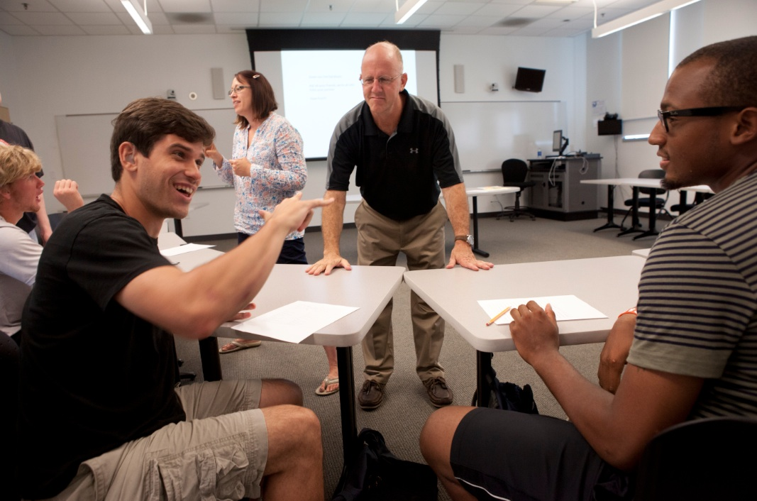
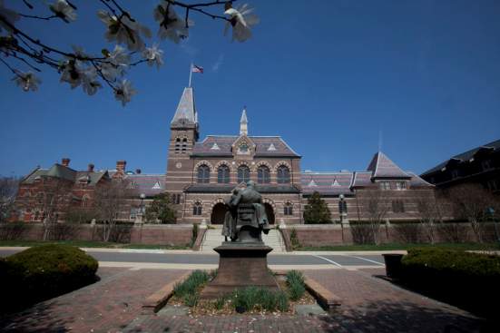
Student Learning at Gallaudet University
NSSE Results: Discussions with Diverse Others
A Workshop Presented to Faculty and Staff for Professional Development
Lindsay Buchko, Ph.D. & Leslie Rach, Ph.D.
Fall, 2018

Slide 2
Questions to consider when you’re reviewing your NSSE results….
What NSSE items are of interest to you and your department?
Given the Gallaudet mission, what results do you want to see on NSSE?
Given your observations and understanding of Gallaudet students, what results do you expect to see?
Do these results resonate with your view of Gallaudet? With other data?
How well do you do in comparison to peers?

Slide 3
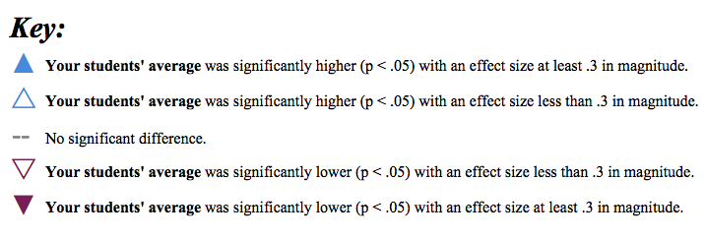
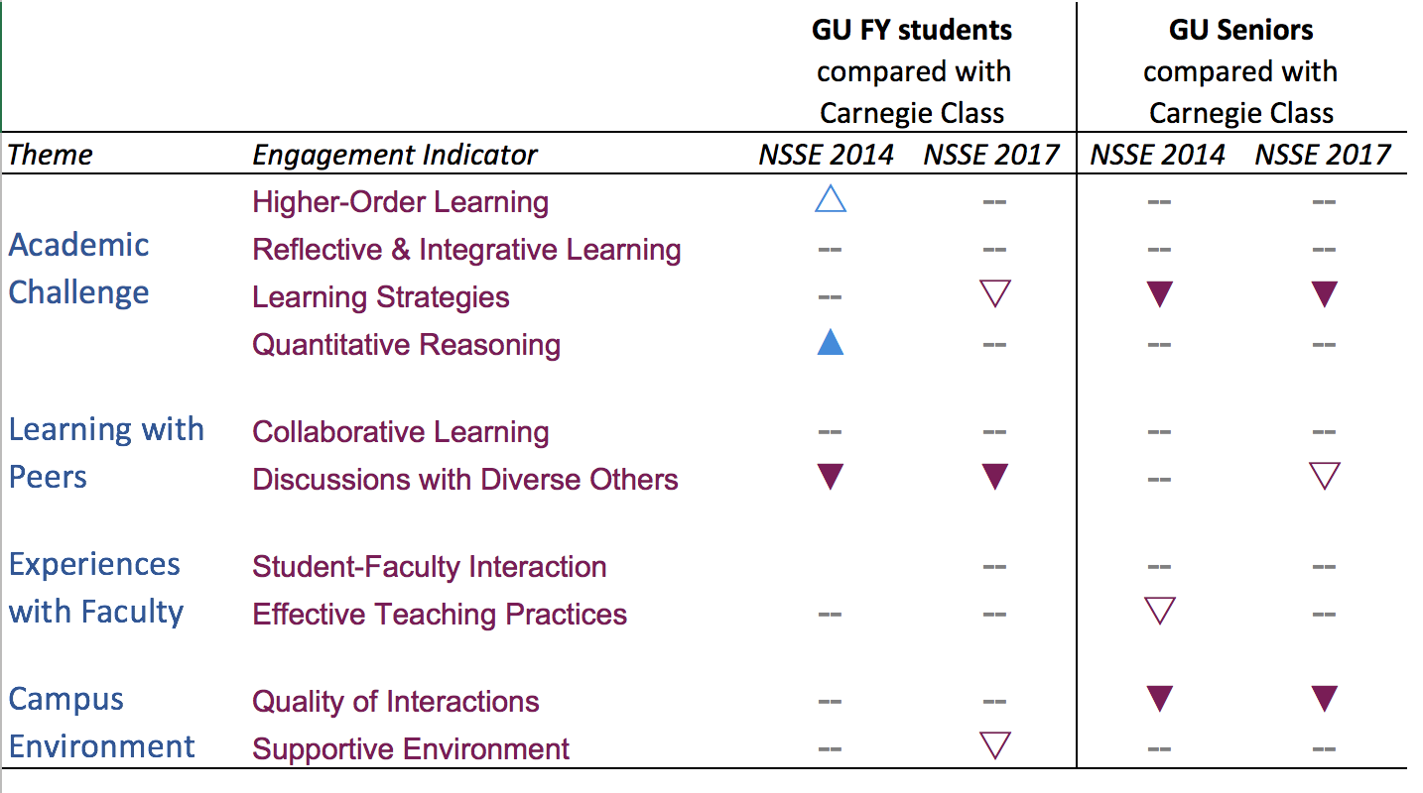
NSSE Engagement Indicators Overview
Notes:
The triangles show Engagement Indicators where our students’ average was significantly higher, and where our students’ average was significantly lower.
As you might guess, if the triangle points up, and is in blue, GU results were higher than peers’; if the triangle points down, and is in purple, GU results were significantly lower. The darker the triangle the more significant the difference. Where there is a line, GU’s results are on par with results of peer institutions.
WHAT DO YOU NOTICE?

Slide 4
NSSE Engagement Indicators: Peer Comparisons
First Year Students
Seniors
= Peers
Higher-Order Learning
Reflective & Integrative Learning
Quantitative Reasoning
Collaborative Learning
Student-Faculty Interaction
Effective Teaching Practices
Quality of Interactions
Below Peers
Learning Strategies
Discussions with Diverse Others
Supportive Environment
= Peers
Higher-Order Learning
Reflective & Integrative Learning
Quantitative Reasoning
Collaborative Learning
Student-Faculty Interaction
Effective Teaching Practices
Supportive Environment
Below Peers
Learning Strategies
Discussions with Diverse Others
Quality of Interactions
Notes:
In 2017, out of 10 Engagement Indicators GU is on par with peers in six Engagement Indicators for both FYS and SRS. (Review the seven). GU is on par with peers for FYS for an additional EI, and on par with peers for Seniors for a different EI (see orange).
For two Engagement Indicators GU is below peers for by FYS and Seniors:
Learning Strategies and Discussions with Diverse Others.
For Quality of Interactions FYS are on par with peers, but Seniors are below peers.
For Supportive Environment Seniors are on par with peers, by FYS are below peers.
(see blue)

Slide 5
NSSE 2017 Engagement Indicator: Discussions with Diverse Others
Notes:
Interactions (“Discussions”) with Diverse Others has been repeatedly shown in research to correlate with a variety of higher education outcomes.
We can guess why: One of the top values of a college education is learning about a variety of perspectives and experiences, and much of what students learn is from each other.
Also, discussions with a wide variety of other students can strengthen the sense of being part of a campus community; in other words, a sense of belonging.

Slide 6
NSSE Engagement Indicators Overview
Notes:
This Indicator has been a concern for GU for FYS since at least 2014. This year it also became a concern for Seniors.
In the next three slides we’re going to look at the questions that make up this Indicator.

Slide 7
NSSE Learning with Peers Discussions with Diverse Others – First Year Students
During the current school year, about how often have you had discussions with people from the following groups? (% responding Very Often or Often)
Data findings for first year students
Gallaudet lower for all items in 2017 compared to Carnegie
Gallaudet 2017 lower for all items compared to Gallaudet 2014
How and in what ways can Gallaudet improve first year students’ discussions with diverse others?

Slide 8
NSSE 2017: Discussions with Others – First Year Students
Comparisons to Peers
Notes:
This graph shows GU student responses to the the question of “How often have you had discussions with people from the following groups” for four groups (name four types per color key; e.g., People of race or ethnicity other than your own is BLUE). Responses are grouped in three categories: Never, Sometimes, and Often or Very Often. These graphs also compare GU student responses– on the left for each category--to Peer student responses—on the right for each category.
One thing that stands out is the higher levels of frequency for “NEVER have discussions” for GU students, especially with regards to Economic Background and Political Background. Accordingly, GU students are less likely than Peers to say they Often or Very Often have discussions with others with different race or ethnicity, religious, economic, and political backgrounds. These are the areas that pulled down GU’s overall score on this Engagement Indicator.
We may want to expand intentional efforts across campus to include discussions with people who are different in race or ethnicity, politically, in religious beliefs, and from a different economic background. You may be thinking now: What can my unit do to increase students’ discussions with a wider variety of diverse others.

Slide 9
NSSE Learning with Peers Discussions with Diverse Others – Seniors
During the current school year, about how often have you had discussions with people from the following groups? (% responding Very Often or Often)
Data findings for first year students
Gallaudet lower for all items in 2017 compared to Carnegie except with race or ethnicity other than their own
Gallaudet 2017 lower for all items compared to Gallaudet 2014
How and in what ways can Gallaudet improve seniors’ discussions with diverse others?

Slide 10
NSSE 2017: Discussions with Others – Seniors
Comparisons to Peers
Notes:
This graph shows GU student responses to the the question of “How often have you had discussions with people from the following groups” for four groups (name four types per color key; e.g., People of race or ethnicity other than your own is BLUE). Responses are grouped in three categories: Never, Sometimes, and Often or Very Often. These graphs also compare GU student responses– on the left for each category--to Peer student responses—on the right for each category.
One thing that stands out is the higher levels of frequency for “NEVER have discussions” for GU students, especially with regards to Economic Background and Political Background. Accordingly, GU students are less likely than Peers to say they Often or Very Often have discussions with others with different religious, economic, and political backgrounds. These are the areas that pulled down GU’s overall score on this Engagement Indicator.
One piece of positive news is that GU students are equally likely as peers to say they have discussions with people of a race or ethnicity other than their own. I would guess that this is related to the intentional efforts made across campus for these discussions to happen.
We may want to expand intentional efforts across campus to include discussions with people who are different politically, in religious beliefs, and from a different economic background. You may be thinking now: What can my unit do to increase students’ discussions with a wider variety of diverse others.

Slide 11
NSSE Engagement Indicators Focus on Discussion with Others and Quality of Interactions EI’s
No correlation for First Year Students
Significant correlation for Seniors
Engagement Indicator Mean | Engagement Indicator Mean
Discussions with Diverse Others Lower | Quality of Interactions Lower
Correlation
Notes:
First, looked at the relationship (correlation) between Discussions with Diverse Others and Quality of Interactions at Gallaudet.
We saw that, although there was no correlation for First Year Students, there was a significant correlation for Seniors. In other words, Seniors who reported Discussions with Diverse Others less often, were more likely to say that the quality of their interactions at Gallaudet was lower than students who reported they had Discussions more often.
The next two slides break this down more within Discussions with Diverse Others, and show how GU student responses compare with those of peer universities.

Slide 12
NSSE Engagement Indicators
Comparing Historically Underrepresented Students (HURS) with Non- HURS
First Year Students | Seniors
No significant difference on any Engagement Indicator | One Significant Difference Discussions with Diverse Others (HURS lower)
Student – Faculty Interaction
Notes:
12
For Seniors, Discussions with Diverse Others was also the ONE Engagement Indicator for which there was a significant difference between Historically Underrepresented Students (HURS) and the remainder of the student body.
This means that HURS Seniors were even less likely to have Discussions with Diverse Others than non-HURS students. Again, this leads us to ask ourselves “What intentional actions can we take to change this?”

Slide 13
NSSE Engagement Indicators
Comparing Historically Underrepresented Students (HURS) with Non-HURS
 | Seniors HURS* | Seniors Non-HURS* | Difference
Engagement Indicator: Discussion with Diverse Others | 30.07 | 37.71 | 7.64
Item: Had discussions with people of a race and ethnicity other than their own | 2.70 | 3.09 | 0.39
Item: Had discussions with people from an economic background other than their own | 2.67 | 2.96 | 0.29
Item: Had discussions with people with religious beliefs other than their own | 2.49 | 2.71 | 0.22
Item: Had discussions with people with political views other than their own | 2.31 | 2.70 | 0.39
Student – Faculty Interaction
*Engagement Indicator scores are converted and expressed on a 60-point scale whereas items are on a 4-point scale.
Notes:
13
For Seniors, Discussions with Diverse Others was also the ONE Engagement Indicator for which there was a significant difference between Historically Underrepresented Students (HURS) and the remainder of the student body.
This means that HURS Seniors were even less likely to have Discussions with Diverse Others than non-HURS students. Again, this leads us to ask ourselves “What intentional actions can we take to change this?”

Slide 14
Questions to consider….
Given the Gallaudet mission, what results do you want to see on NSSE?
Given your observations and understanding of Gallaudet students, what results do you expect to see?
How and in what ways can Gallaudet improve students’ discussions with diverse others?
What strategies can Gallaudet implement to improve students’ discussions with diverse others?

Slide 15
Continued Discussion….
Tuesday, August 21st at 10:30am to Noon
Strategies for Key Indicators: Discussions with Diverse Others
Room: MLCB 220 (E-Learning Lab)

Slide 16
Supportive Classroom Environments
Resources
Engaging in Conversations about Gender, Race, and Ethnicity in the Workplace
How to Help Diverse Students Find Common Ground
Increasing Inclusivity in the Classroom
Howard Thurman Center for Common Ground (could we implement these at Gallaudet?)
Strategies
Inclusion by Design Syllabus Template

