Slide 1
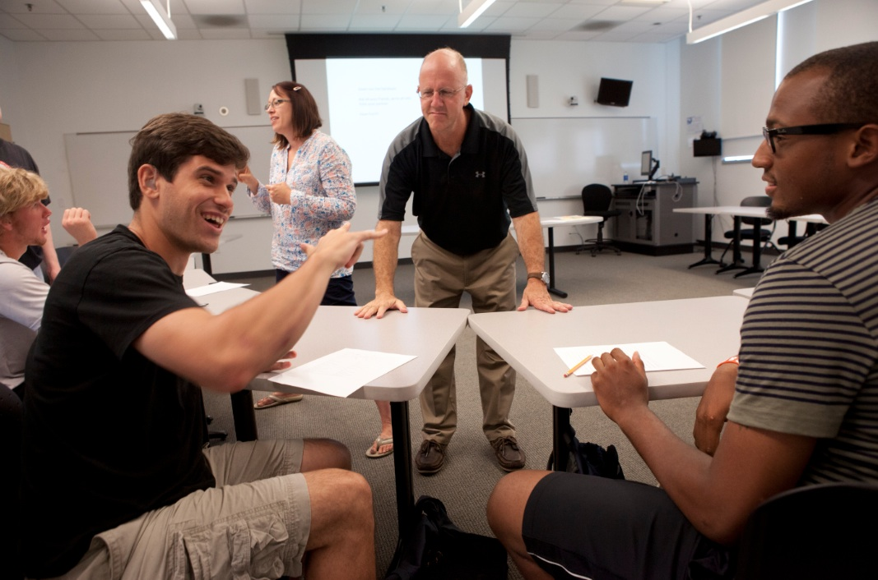
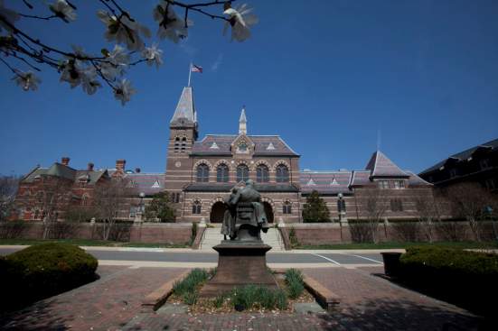
Student Learning at Gallaudet University
NSSE Results: Introduction
A Workshop Presented to Faculty and Staff for Professional Development
Lindsay Buchko, Ph.D.
Director of Institutional Research
Fall, 2018

Slide 2
NSSE 2017 Workshop Topics
Monday Morning
NSSE & Student Engagement: Overview
Meaningful Educational Experiences & High Impact Practices
NSSE 2017 Administration at Gallaudet
Monday Afternoon
Selected NSSE Results for Gallaudet
Engagement Indicator Results and Comparisons
Academic Challenge
Learning with Peers
Campus Environment
Tuesday All Day
NSSE Data to Action

Slide 3
Foundational Assertion
We all want the same thing—an undergraduate experience that results in high levels of learning and personal development and success for all students.
Student retention is about engaging students in high levels of educationally purposeful activities.

Slide 4
NSSE & Student Engagement:
Overview

Slide 5
Two Components of Student Engagement
What students do – Time and energy devoted to educationally purposeful activities
What institutions do – Using effective educational practices to induce students to do the right things
Notes:
5
Development of Concept of Student Engagement
C. Robert Pace (1970s)
Pioneer of looking at the entire student experience versus just looking at test scores or grades to assess student learning.
Explored students’ academic and social experiences in college – and assessed the quality of effort students put forth in their educational experiences
Alexander Astin (Hired by Pace at UCLA in 1980s)
Promoted theory of student involvement
Amount of learning taking place directly proportional to quantity and quality of energy invested in educational activities
Vincent Tinto (Also in the 1980s)
Retention model – focus on greater social and academic integration, both formal and informal processes -> greater satisfaction -> more likely to stay
Ernest Pascarella & Patrick Terenzini
Examined impact of college experience.
Arthur Chickering and Gamson (1980s analysis of hundreds of studies over several decades)
Good practice in undergraduate education includes: 1) Student-faculty contact, 2) Cooperation among students, 3) Active learning, 4) Prompt feedback, 5) Time on task, 6) High expectations, 7) Respect for diverse talents and ways of learning
George Kuh (1990s – idea of student engagement)
What students do -- time and energy devoted to educationally purposeful activities
What institutions do -- using effective educational practices to induce students to do the right things

Slide 6
Summary:
Student success in college is no accident
Student engagement in intentionally designed educationally purposeful activities is necessary to achieve desirable learning outcomes.
Institutions must deploy resources appropriately and provide students explicit messages about success oriented behaviors.
Institutions need information about how well they’re doing & to use this information to enhance student engagement and success.

Slide 7
What do we know about student engagement….
Grades, persistence,
student satisfaction,
and engagement go
hand in hand

Slide 8
Conditions that Support Retention
Provide clear and consistent information to students as well as the advice they need to arrive at reasonable decisions about their programs of study and future career goals.
Provide academic, social, and personal support that is readily available and connected to other arts of student collegiate experience to retention.

Slide 9
Conditions that Support Retention
Involve students as valued members of institution. Frequency and quality of contact with faculty, staff, and other students is an important independent predictor of student persistence.
Foster learning. Learning has always been the key to student retention. Students who learn are students who stay. Institutions that are successful in building settings that educate their students are successful in retaining their students. Students are involved in learning, that is, who spend more time on task, especially with others, are more likely to learn and, in turn, more likely to stay. (Tinto, 2002)

Slide 10
What to Make of This?
When faculty members emphasize certain educational practices, students engage in them to a greater extent than their peers elsewhere.

Slide 11
NSSE Survey & Administration
NSSE = College student survey that assesses the extent to which students engage in educational practices associated with high levels of learning and development
Students surveyed in the spring
Population survey of first-year students & seniors
Web-based administration
More than 1,600 baccalaureate-granting colleges and universities in the US and Canada have participated to date.
NSSE 2017: 722 institutions participated
Notes:
The National Survey of Student Engagement (NSSE) aseses the kinds of practices described in the previous slides.
The next few slides will explain the administration of the NSSE and give you some more specifics about the content.
Lindsay: I’m Not sure if GU uses a random sample or full population (because of small numbers here)

Slide 12
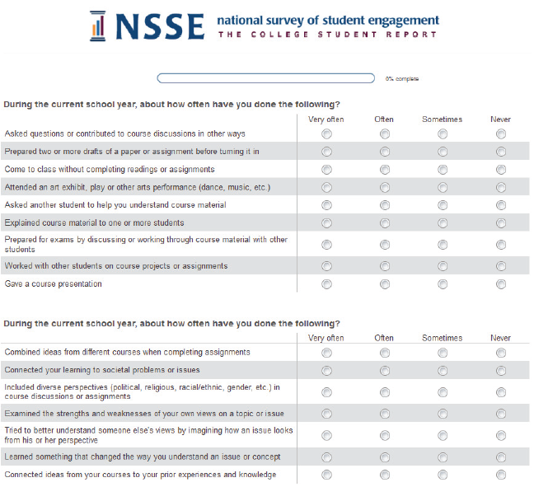
Taking a Look at NSSE
Designed and tested for high validity and reliability
High credibility of self-reported data
Students will participate
Actionable data
Psychometric properties on web
Notes:
This slides shows why and when Gallaudet administers NSSE.
The Center for Survey Research at Indiana University helps NSSE administer the survey in the field. See: csr.indiana.edu for more information.
NSSE survey design:
Relatively short survey
Items directly related to college outcomes
Administered to first-year and senior students at 4-year institutions
Administered directly by a credible third-party survey organization

Slide 13
NSSE Survey Content
Engagement in meaningful
academic experiences
Student learning
& development
Engagement in High-Impact Practices
Student reactions
to college
Student background
information
Notes:
The NSSE survey asks students to report the frequency with which they engage in activities that represent effective educational practice. Students also record their perceptions of the college environment associated with achievement, satisfaction, and persistence. Then, students estimate their educational and personal growth since starting college. Finally, students provide information about their background, including age, gender, race or ethnicity, living situation, educational status, and major field.
This presentation will focus primarily on the first two: Engagement in meaningful academic experiences and Engagement in High Impact Practices. The next slides will go into more detail on what these mean.

Slide 14
Goals of NSSE Project
Diagnostic; a window into the undergraduate experience
Help pinpoint aspects not in line with mission, or with what GU expects
Discover weaknesses and strengths in educational programming
Help GU know what to focus on to improve student learning and success

Slide 15
Using NSSE Results for Institutional Improvement
NSSE results provide opportunity for reflection on institutional performance
Are we doing as well as we claim?
How are we doing in comparison to our peer institutions?
How do our results align with current institutional priorities and plans?

Slide 16
Meaningful Educational Experiences & High-Impact Practices

Slide 17
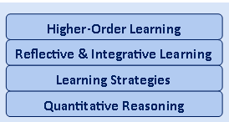
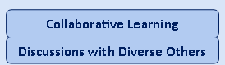
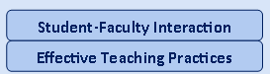
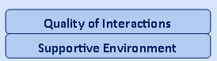
Meaningful Educational Experiences: NSSE Engagement Indicators
Academic Engagement Themes
Engagement Indicators
Academic Challenge
Learning with Peers
Experiences with Faculty
Student – Faculty Interaction
Campus Environment
Notes:
17

Slide 18
High-Impact Activities
First-Year Seminars and Experiences
Common Intellectual Experiences
Learning Communities
Writing-Intensive Courses
Collaborative Assignments and Projects
Undergraduate Research
Diversity/Global Learning
Service Learning, Community-Based Learning
Internships
Capstone Courses/Projects
https://www.aacu.org/leap/hips
Notes:
18
18
Of all the educational experiences students have, there’s one kind that seems to have a strong positive effect on learning. They’ve been called High-Impact Practices. Why – because they have a HIGH Impact on student learning.
Which of these seem familiar to you? Which have you seen at Gallaudet?
Pat ourselves on the back for that! In other words, the effect for HURS is particularly beneficial.
But we’re not done yet….

Slide 19
HIPs: What We Know for Sure
HIP participation is positively related to several educational outcomes
Salutary effect for historically underserved students
Desired by employers
Enjoyable to students & faculty
HIP participation is growing
Notes:
These teaching and learning practices have been widely tested and have been shown to be beneficial for college students from many backgrounds. This effect is particularly beneficial for historically underserved students. And yet, until recently, most universities have not systematically looked at who experiences HIPS and who doesn’t. Nor have they looked at when, where and how often students’ experience HIPS.

Slide 20
Eight Key Elements of High-Impact Practices
Performance expectations set high
Significant investment of time & effort by students over extended period of time
Interactions with faculty & peers about substantive matters
Experiences with diversity—students exposed to and must connect with people & circumstances different from familiar
Frequent, timely, and constructive feedback
Structured opportunities to reflect & integrate
Opportunities to discover relevance of learning through real-world applications
Public demonstration of competence
Kuh, G. D., O’Donnell, K., & Reed, S. (2013). Ensuring quality and taking high-impact practices to scale. Washington, D.C.: Association of American Colleges and Universities.
Notes:
In other words, the stronger the HIP is in these characteristics, the bigger the impact of the HIP experience. It’s not enough just to DO a HIP – High Impact Practices have an impact based on the extent to which they have the characteristics listed above.
So, for example, a student MIGHT participate in an field experience that DOES NOT have have performance expectations, or interactions with faculty, frequent and constructive feedback, or structured opportunities to reflect. And it won’t have much of an impact.

Slide 21
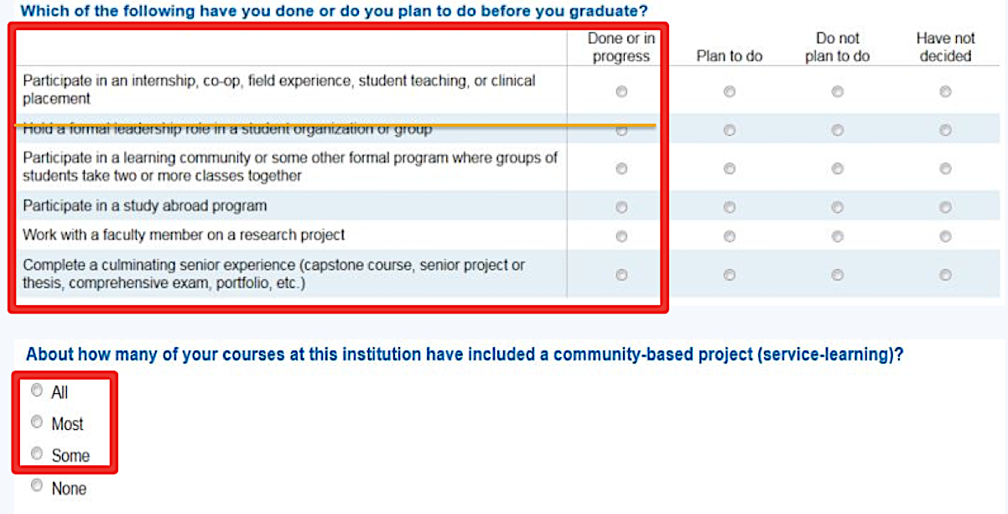
HIPS on the 2017 NSSE Survey
Notes:
Six items on the NSSE survey ask about High Impact Practices (review the five experiences plus courses with community based projects).
NSSE provides data on participation in a formal leadership role but it is not considered a High Impact Practice.

Slide 22
The High Impact Practice (HIP) Goal
It is recommended for every student to participate
in at least two high - impact activities (Kuh, 2008).
One in the first - year
and one later, in the major.
Notes:
TWO HIP’s in a student’s entire academic career. Seem reasonable, right? Later in the presentation we can compare this Goal to GU’s results.

Slide 23
The High Impact Practice (HIP) Challenge
Equity in HIP Involvement
Equity in all learning opportunities supports equity in learning outcomes
See Assessing Underserved Students Engagement in High Impact Practices
https://www.aacu.org/sites/default/files/files/assessinghips/AssessingHIPS_TGGrantReport.pdf
Notes:
HIP’s are an important learning opportunity for students. Some, including students, say that HIP’s are the MOST important learning opportunity of all.
But as with all learning opportunities, access is not always equitable.
When we look at GU’s results we’ll also look at the break-down by race-ethnicity.

Slide 24
NSSE 2017 Administration at Gallaudet University
Notes:
The next few slides will give you a little background on NSSE use at Gallaudet.

Slide 25
GU NSSE 2017 Survey Population and Respondents
GU administers NSSE tri-annually
Student Satisfaction Inventory for non-NSSE years
Gallaudet administered first year students (freshmen) and seniors in 2008, 2010, 2012, 2014, and 2017
451 Gallaudet students were invited to participate, with 256 responding

Slide 26
Response Rates
Gallaudet University’s response rate = 57%
All NSSE 2017 Institutions = 30%
NSSE 2017 U.S. Average Institutional Response Rates by Enrollment
Undergraduate Enrollment | Number of Institutions | Avg. Institutional Response Rate
2,500 or fewer | 302 | 36%
2,501 to 4,999 | 124 | 29%
5,000 to 9,999 | 114 | 23%
10,000 or more | 96 | 22%
All institutions | 636 | 30%
Notes:
You can see that the response rate tends to be higher for smaller institutions, but even with the comparison to smaller size institutions, GU’s response rate was very strong.
Note: The NSSE 2017 response rate is the average institutional response rates (not the overall student response rate)

Slide 27
Selected NSSE Results for
Gallaudet University

Slide 28
Questions to consider when you’re reviewing your NSSE results….
What NSSE items are of interest to you and your department?
Given the Gallaudet mission, what results do you want to see on NSSE?
Given your observations and understanding of Gallaudet students, what results do you expect to see?
Do these results resonate with your view of Gallaudet? With other data?
How well do you do in comparison to peers?

Slide 29
NSSE 2017: Engagement Indicator Results & Comparisons
Notes:
In the next set of slides we’ll look at GU results in comparison with peer institutions.
Here we can see what our areas of strength are, and what areas we might want to focus planning on.
Keep in mind that the goal in looking at these results is to see how we can improve the effectiveness of GU for student learning.

Slide 30
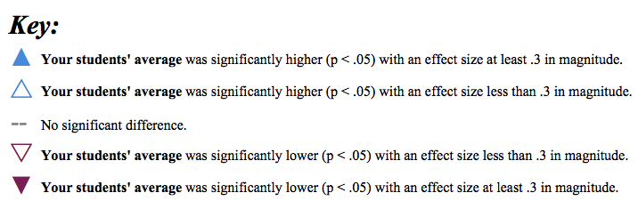
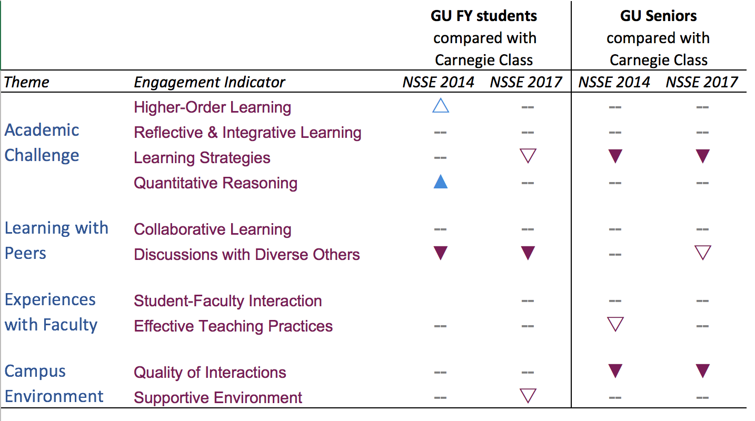
NSSE Engagement Indicators Overview
Notes:
The triangles show Engagement Indicators where our students’ average was significantly higher, and where our students’ average was significantly lower.
As you might guess, if the triangle points up, and is in blue, GU results were higher than peers’; if the triangle points down, and is in purple, GU results were significantly lower. The darker the triangle the more significant the difference. Where there is a line, GU’s results are on par with results of peer institutions.
WHAT DO YOU NOTICE?

Slide 31
NSSE Engagement Indicators: Peer Comparisons
First Year Students
Seniors
= Peers
Higher-Order Learning
Reflective & Integrative Learning
Quantitative Reasoning
Collaborative Learning
Student-Faculty Interaction
Effective Teaching Practices
Quality of Interactions
Below Peers
Learning Strategies
Discussions with Diverse Others
Supportive Environment
= Peers
Higher-Order Learning
Reflective & Integrative Learning
Quantitative Reasoning
Collaborative Learning
Student-Faculty Interaction
Effective Teaching Practices
Supportive Environment
Below Peers
Learning Strategies
Discussions with Diverse Others
Quality of Interactions
Notes:
In 2017, out of 10 Engagement Indicators GU is on par with peers in six Engagement Indicators for both FYS and SRS. (Review the seven). GU is on par with peers for FYS for an additional EI, and on par with peers for Seniors for a different EI (see orange).
For two Engagement Indicators GU is below peers for by FYS and Seniors:
Learning Strategies and Discussions with Diverse Others.
For Quality of Interactions FYS are on par with peers, but Seniors are below peers.
For Supportive Environment Seniors are on par with peers, by FYS are below peers.
(see blue)

Slide 32
Questions?

Slide 33
Future Workshops…
Monday, August 20, 2018
1:00pm to 2:00pm NSSE Results: Learning Strategies
2:00pm to 3:00pm NSSE Results: Discussions with Diverse Others
3:00pm to 4:00pm NSSE Results: Quality of Interactions and Supportive Environment
Tuesday, August 21, 2018
9:00am to 10:30am Strategies for Key Indicators: Learning Strategies
10:30am to 12:00pm Strategies for Key Indicators: Discussions with Diverse Others
2:30pm to 4:00pm Strategies for Key Indicators: Quality of Interactions and Supportive Environment

