Slide 1

National Symposium on Video Interpreting Gallaudet University
May 24, 2010
Examining the Challenges of Trilingual (Spanish-English-ASL) VRS Interpreting
David Quinto-Pozos, Kristie Casanova de Canales, & Rafael Treviño
Gallaudet Research Institute (GRI) 2007-08 national data of
deaf & hard of hearing children: Language used in the home
Language | Number of students | Percentage of students
English | 29,947 | 82.5%
Spanish | 7,948 | 21.9%
ASL | 1,385 | 3.8%
Other | 1,884 | 5.2%
National Symposium on Video Interpreting: The State of the Practice and Implications
Gallaudet University
May 23, 2010
A more complete account of this work:
Outline for our presentation
Quinto-Pozos, D., Casanova de Canales, K., & Treviño, R. (2010). Trilingual video relay service interpreting in the United States.
Brief history of trilingual VRS
Data from our survey research
  Info about our interpreter sample
  Linguistics topics
  Working conditions
  Information from VRS providers
Implications and suggestions for future
In Studies in Interpretation Series, Volume 5: Signed Language Interpreting in Multilingual or Multiethnic Contexts. Gallaudet University Press
Editors: Rachel McKee & Jeff Davis Davis.
Brief History of Trilingual VRS
Brief History of Trilingual VRS
Pilot in Austin
2000
Approved in Texas
Request for compensation
FCC reimburses VRS
Spanish-ASL Not Compensable
2005
FCC Reverses its Decision
Providers must offer services 24/7
1995
2002
2004
2006
DQP: davidqp@mail.utexas.edu
KCC: atyourfingertipsinterpreting@yahoo.com
RT: rafael.trevino@me.com

Slide 2
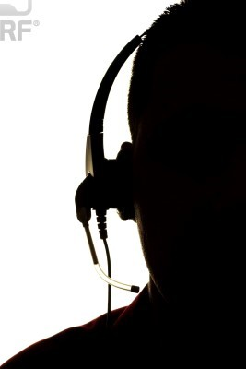
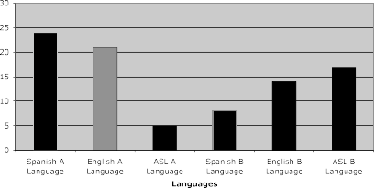
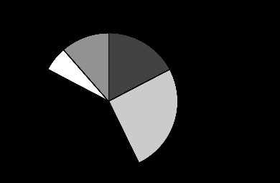












National Symposium on Video Interpreting Gallaudet University
May 24, 2010
Background on Interpreters
Language Proficiency of Interpreters
37 Responded
Language Proficiency
Experience in Interpreting
Assessment of Skills
Years of Trilingual Experience
Assessment of Skills
ASL
Interpreting
English
Spanish
Survey: Spanish Gendered Nouns
Responses: Spanish Gendered Nouns
If your Deaf client uses signs whose Spanish counterparts have gendered variants, which variant do you choose if you do not know the sex of the person who is being described?
#1
Use masculine variant (n=17, 46%)
#2
Request clarification (n=13, 35%)
Other
Avoid using gendered nouns
Use “traditional” variant
Context clues
DQP: davidqp@mail.utexas.edu
KCC: atyourfingertipsinterpreting@yahoo.com
RT: rafael.trevino@me.com

Slide 3
























































National Symposium on Video Interpreting Gallaudet University
May 24, 2010
Some Dialects of Spanish
Differences at the Lexical Level
Bolivian Spanish
Caribbean Spanish
Central American Spanish
Colombian-Ecuadorian Spanish
Mexican Spanish
Northern Mexican Spanish
Puerto Rican Spanish
English “soda”
General refresco
Peru gaseosa
guagua
Differences at the Lexical Level
Survey: Lexical Differences
“blah”
How do you handle words that have one meaning in one Spanish-speaking country and another meaning in a different Spanish-speaking country?
torta
queque
“blah”
“blah”
pastel
biscocho
“blah”
blah
“blah”
“blah”
“blah”
Responses: Lexical differences
Survey: Pronunciation
#1
Context clues (n=14, 38%)
If your Deaf client has a Spanish or Spanish- influenced name, how do you normally pronounce that name to hearing individuals who speak English on the VRS calls?
María
Español:
[Mah-rree-ah] English:
[Muh-ree-uh]
#2
Request clarification (n=12, 32%)
Use a generic term
Other • Explain and compare
DQP: davidqp@mail.utexas.edu
KCC: atyourfingertipsinterpreting@yahoo.com
RT: rafael.trevino@me.com

Slide 4
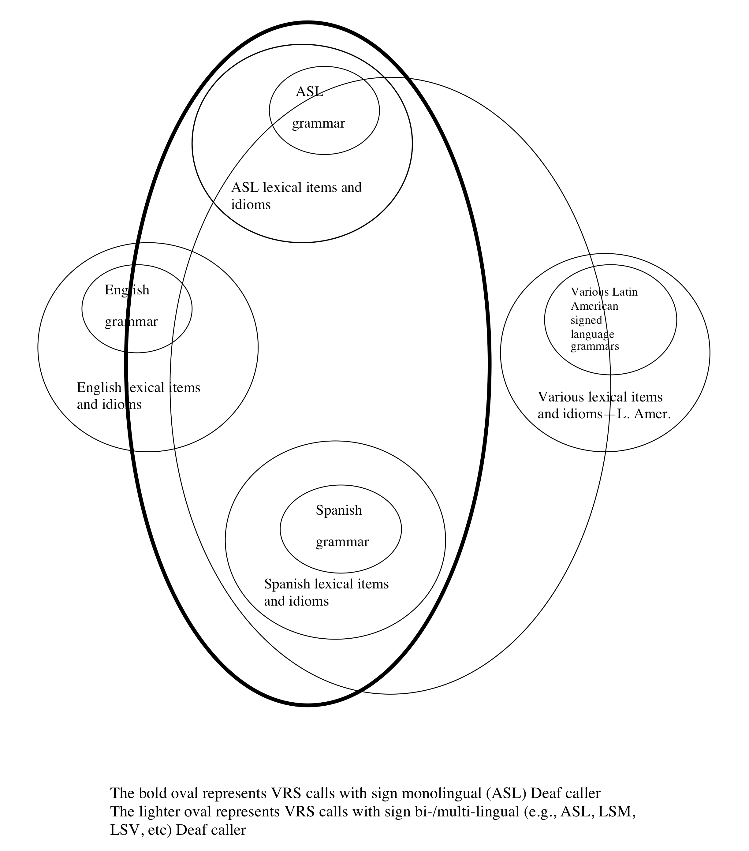




National Symposium on Video Interpreting Gallaudet University
May 24, 2010
Responses: Pronunciation
Model of trilingual VRS interpretation
#1
• Spanish (n=14, 38%)
#2
• English (n=13, 35%)
Use suggestion from caller
Other • Listening for clues
From:
Quinto-Pozos, Casanova de Canales, & Treviño (2010)
Interpreters’ Working Conditions
Interpreters’ Working Conditions
Length of calls
  Average length based on survey results
    Average = 40 min
    Most common = 20 min
  Compared to English
  Multiple calls with the same caller
Average percentage of time spent teaming with another interpreter
  Average = 10%
  Most common = 0%
Interpreters’ Working Conditions
Transferring calls
–Technological limitations
–Supply and demand issues
Interpreters’ Working Conditions
Impact on trilingual VRS work on interpreter health
  Mental fatigue (1/5)
  Physical fatigue (almost 1/2)
  No impact (1/3)
DQP: davidqp@mail.utexas.edu
KCC: atyourfingertipsinterpreting@yahoo.com
RT: rafael.trevino@me.com

Slide 5




National Symposium on Video Interpreting Gallaudet University
May 24, 2010
VRS Providers’ Input
How Spanish competency is assessed
  Third party assessment
  In-house assessment
VRS Providers’ Input
Trilingual- specific Training
–Mentoring workshop
–Observations
VRS Providers’ Input
VRS Providers’ Input
Compensation
- Three out of four providers interviewed say trilingual interpreters receive more compensation
Length of calls
  3 out of 4 claim longer than English-ASL calls
  Cited times: 5 min
15 min
17 min
Teaming
–“possible”
Transferring
VRS Providers’ Input
VRS Providers’ Input
Additional comments or concerns
  This field is growing
  Need for RID’s support of this specialization
  Demand exceeds supply, Hispanic community underserved
  Need certification exams and training opportunities for trilingual interpreters
Where do calls originate or terminate?
–Mexico
–Colombia
–Puerto Rico
–Cuba
–Costa Rica
DQP: davidqp@mail.utexas.edu
KCC: atyourfingertipsinterpreting@yahoo.com
RT: rafael.trevino@me.com

Slide 6

National Symposium on Video Interpreting Gallaudet University
May 24, 2010
Implications for the future
Provide more training opportunities for interpreters
Engage in dialogues with stakeholders about pre-call synopses
Provide additional support during calls
We would like to thank the interpreters, VRS agencies, and Deaf consumers who participated in this research
For a more thorough account of Trilingual VRS, see Quinto-Pozos, D., Casanova de Canales, K., & Treviño, R. (2010). Trilingual video relay service interpreting in the United States. In Studies in Interpretation Series, Volume 5: Signed Language Interpreting in Multilingual or Multiethnic Contexts. Eds. R. McKee & J. Davis. Washington, DC: Gallaudet University Press, pp. 28-54.
DQP: davidqp@mail.utexas.edu
KCC: atyourfingertipsinterpreting@yahoo.com
RT: rafael.trevino@me.com

