Slide 1
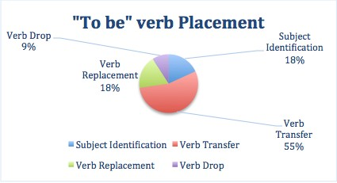
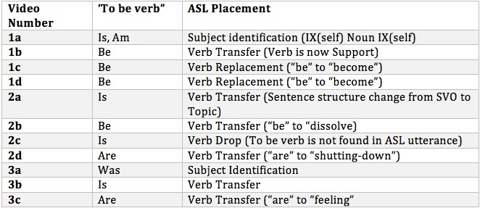
To Be Or Not To Be
Analysis of English “to be” verbs in ASL interpretations
Billy Sims
Introduction
Data Collection/ Methodology
For the process of this research paper we will be looking at three different sources of interpreting from English to ASL. Each source will have three sections that will be analyzed. The sections chosen for this paper were chosen based on the English use of “to be.” Primarily this research will look at the verb when it is used by itself and not as a verb phrase. For example, I chose sentences that contained subjective complements like “I am a teacher,” where the verb is an intransitive verb renaming the subject. Most of the sentences analyzed where simple sentence that followed English’s Subject Verb order.
Analysis and Findings
Conclusion
Many linguistic challenges face sign language interpreters every day. One prominent challenge is interpreting “to be” verbs from English into American Sign Language. The English verb “to be” is
used as a function verb for verb phases, renaming subjects or objects, functioning intrinsically, etc
. (Lennie, 2016). All English verbs in clauses are conjugated to make the subject and tense
(Lennie, 2016). These features present themselves in different ways in ASL. ASL has no direct
verb that means “to be,” but does possess multiple
types of verbs that can convey an equal meaning. This research will look at four different interpreters approach to take a spoken
English sentence with the verb “to be,” and producing an ASL utterance of equal meaning.
Literature Review
The research surrounding verbs in ASL have seen a variety of publications. One of these is a chapter written by Carol Padden in a book called Sign Language Research: Theoretical Issues (Padden 1990). Padden’s research introduced three main types of ASL verbs: plain, inflecting (agreement), and spatial. These three verb types in ASL help define how verbs function in ASL and thus how interpreters can use these to interpret. The second research source used for this paper was written in 1988 by William Stokoe and E. Lynn Jacobowitz. Their article in the 60th Volume of Sign Language Studies looks into how ASL expresses tense in their verbs. Their research that, though ASL does not conjugate their verbs in the same way English does (Ie. Come, came), ASL indicates tense at a different linguistic level than English. The third source for this research looked at deaf student’s acquisition of English verbs. This research done by Berent et al. compared deaf student’s understanding of intransitive and transitive verbs to that of their hearing peers.
The results of looking at “to be” verb placements were mildly surprising. The videos used to collect this data showed that there are four approaches to interpreting “to be” verbs. The most used in this research was Verb Transfer, a term created for this research to identify when an interpreter changes the structure of the utterance to have the verb be placed on another word/sign. The second most used strategy for “to be” was tied between Verb Replacement and Subject Identification. Both are terms made up for this research, a Verb Replacement takes the “to be” verb and finds and ASL equivalent. This is different from transfer because the verb is still in the same format as the English utterance, but uses an ASL synonym.
Subject Identification was an approach
used when the “to be” verb was intransitive and functioning as a subjective complement, where the interpreter was identifying the subject, the noun that renamed the subject, and the subject again. The final approach was Verb Drop where the original English sentence and the ASL utterance had the same structure, but the ASL utterance was lacking the “to be” verb or an equivalent. In the 11 utterances looked at, 55% were Verb Transfer, 18% were Verb Replacement, 18% were Subject Identification, and 9% were Verb Drop.
Sign language interpretation from English to ASL contain many different approaches and challenges. A frequent challenge with English to ASL interpretation is handling English’s use of “to be” verbs. These verbs are function verbs that re-describe the subject, work in phrases to indicate tense, and describe states of being. This research looked at three different interpreters, and their approaches to interpreting “to be” verb phrases into ASL. In the 11 utterances looked at, 55% were Verb Transfer, 18% were Verb Replacement, 18% were Subject Identification, and 9% were Verb Drop. These approaches were all a different way of handling a “to be” verb but still accurately maintain the message and intention of the sentence.
There were three videos analyzed for this research. The first was a commencement address for the graduating class of 2012 at the University of Iowa College of Pharmacy. The second video used a TEDx talk done in 2010. This was a presentation done by a deaf white male, who was deaf but spoke and had cochlear implants.
The third and final video was a University of South Florida 2013 Student Success Conference
References
Berent, G. P. (2013). DEAF STUDENTS' KNOWLEDGE OF SUBTLE LEXICAL PROPERTIES OF TRANSITIVE AND
INTRANSITIVE ENGLISH VERBS. In American Annals of the Deaf (pp. 158(3), 344-62).
Grammar, Gesture, and Meaning in American Sign Language . (2003). In S. Liddell, A Sketch of the Grammar of ASL (pp. 2-65). New York, NY: The Press Syndicate of the University of Cambridge .
Padden, C. (1990). The Relation Between Space and Grammar in ASL Verb Morphology . In C. Lucas, Sign Language Research: Theoretical Issues (pp. 118-133). Gallaudet University Press.
RESEARCH POSTER PRESENTATION DESIGN © 2015
www.PosterPresentations.com

