Slide 1
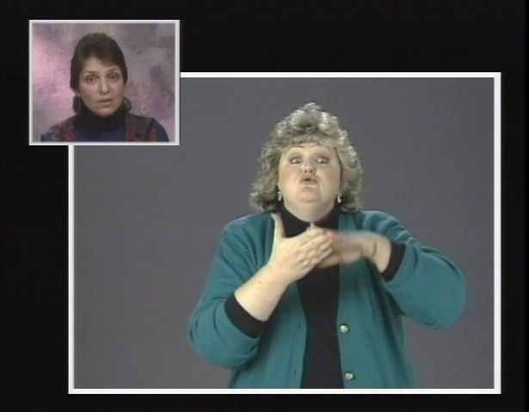
Interpreting Defocused Agent Construals from spoken English to American Sign Language
By Sheila Jackson, INT 492.01, Spring 2016
LITERATURE REVIEW
Valli, C., Lucas, C., & Mulrooney, K. J. (2005) Basic word order for ASL sentences are SVO and SV. CA and CD are narratives or performances in language use.
Evans, V., & Green, M. (2006) Passive construction moves focus from agent to the patient by leaving the agent out enHrely.
Langacker, R. (2006) Defocused agents can be construed by describing a participant, locaHon, or noun with less speciﬁcity.
Janzen, T., O’Dea, B., & Shaﬀer, B. (2001) Defocusing an agent is possible by assuming the subject from a prior statement or using a less obvious agent like SOMEONE.
Villanueva, M. N. (2010) NaHve ASL users construe defocused agents.
METHODS
Collected ﬁve spoken, passive constructions from spoken English lecture called Living Fully on the DVD entitled Interpreting Practice DVD by Sign Enhancers
Analyze the strategies used by one interpreter to interpret the spoken English passives
DISCUSSION
Interpreter inserted an agent or omitied the defocused agent clause all together.
No instance where the interpreter construed the same passive as the original speaker.
This analysis shows that interpreters may not naturally use or acquire ASL structures which defocus agents and it is something that may need to be taught.
RESULTS
Three strategies used by one interpreter:
CONCLUSIONS
InserHon of an overt agent
Assuming the role of an agent through constructed action and constructed dialogue
Omission
Intended Subtleties: While interpreters often search for meaning in source language, intended subtleties can be lost if the speaker’s construal is overlooked.
REFERENCES
Evans, V., & Green, M. (2006). Cognitive Linguistics: An introduction. Edinburgh University Press Ltd. (54-105).
Janzen, T., O’Dea, B., & Shaﬀer, B. (2001). The construal of events: Passives in American Sign Language. Sign Language Studies. 1(3), 281-310.
Langacker, R. (2006). Dimensions of defocusing. Voice and grammatical relations. In T. Tasaku (Ed.), In honor of Masayoshi
Shibatani (115-137). Philadelphia: John Benjamins Publishing Company.
Sign Enhancers (Producer), Interpreting pracHce: Specialized interpreting. (1992]2009) [EducaHonal DVD]. San Diego: American
Sign Language Productions, Inc.
Valli, C., Lucas, C., & Mulrooney, K. J. (2005). Linguistics: of American Sign Language an introduction (4th ed.). Washington, DC: Gallaudet University Press.
Villanueva, M. N. (2010). Non-agent focused constructions in American Sign Language: A cognitive linguistic analysis. (Unpublished doctoral dissertation).
Villanueva, M. N. (2012). Defocused agent expression in American Sign Language [PowerPoint slides].
InserQon of Overt Agent
Three teachers had been brought into the principal’s oﬃce and told, “You three teachers are the best three in the whole school.” | PRINCIPAL SUMMONED 3 TEACHER G(c’mon) 3+++ PRINCIPLE STATEMENT WHAT IX(teacher) BEST MOST IN OUR SCHOOL
Constructed Action & Constructed Dialogue
These teachers were asked, “Don’t tell any of the students or the parents about this.” | G(stop) BUT IX(teachers) MUST CONFIDENTIAL NOT ANNOUNCE TEACHER OTHER NOT ANNOUNCE PARENTS NOT ANNOUNCE STUDENT #OK?
Omission
At the end of the year, it was found that these students tested signiﬁcantly higher than all of the students. | TIME-MOVES-ON+++ ONE-YEAR PASS IX(student) STUDENT WHAT MOVE-UP-IN-RANKINGS DID GOOD IX(student) SCORES BEST IN SCHOOL
Cultural MediaQon: While hearing people may assume information from a passive construal, the assumptions are based oﬀ of prior experience and cultural knowledge.
K-12 Interpreting: Teachers purposefully construe utterances with defocused agents as a strategy to teach criHcal thinking skills and other skills.
Legal and Medical Signs: Allow for eﬀective interpretations of implicit language in legal and medical settings, and may improve the overall interpreting process and interpretation
RECOMMENDATIONS
Fellow researchers are encouraged to support or critique this research using entirely new recordings with samples from multiple interpreters spanning a range of ages and training backgrounds.

