Slide 1
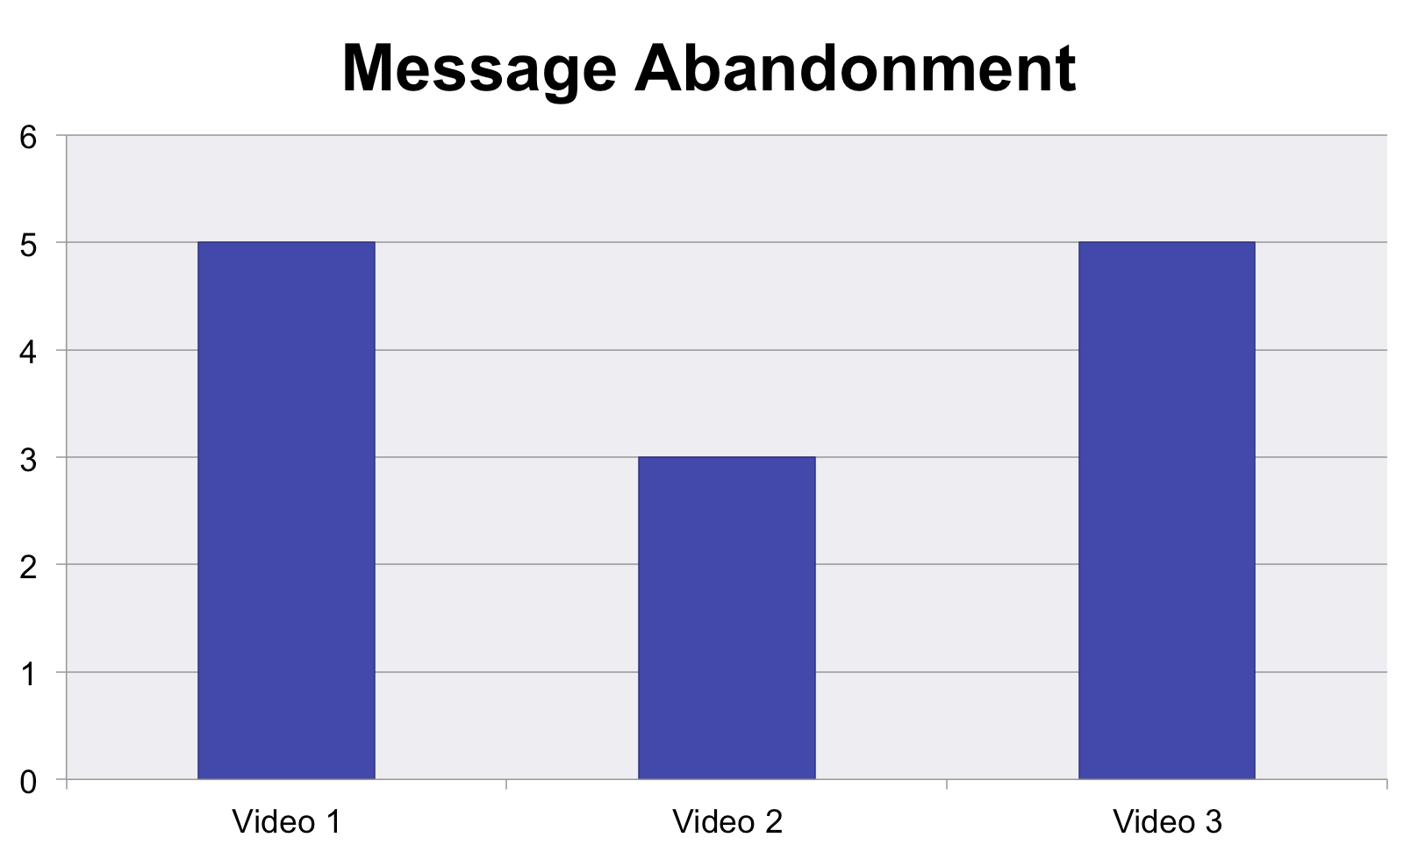
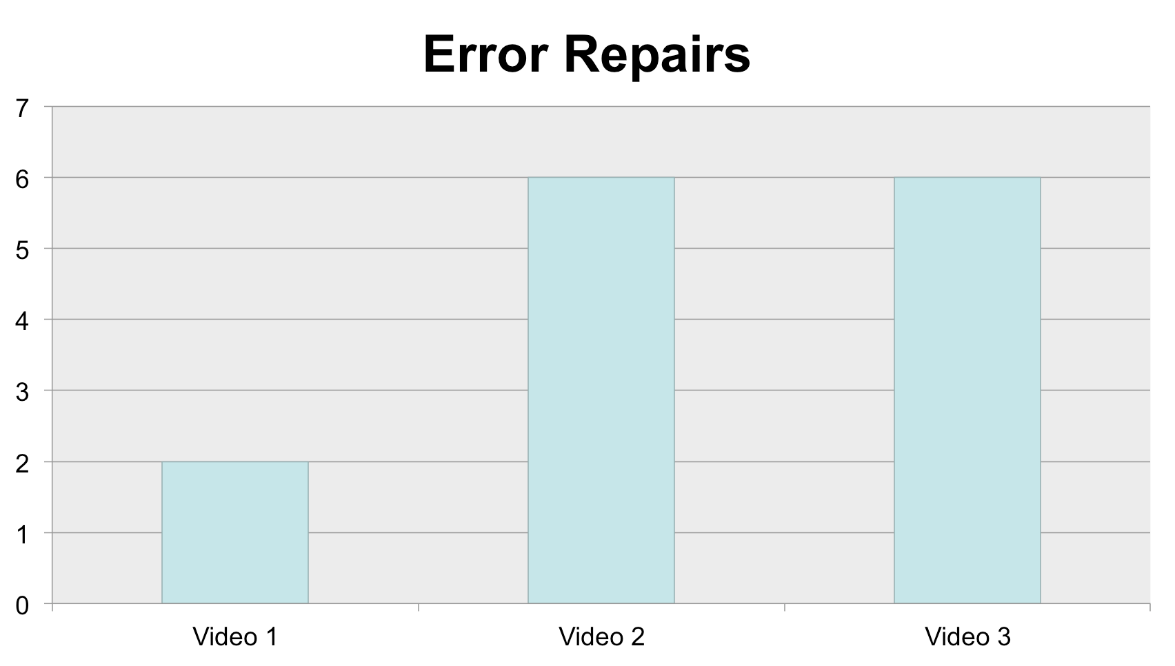
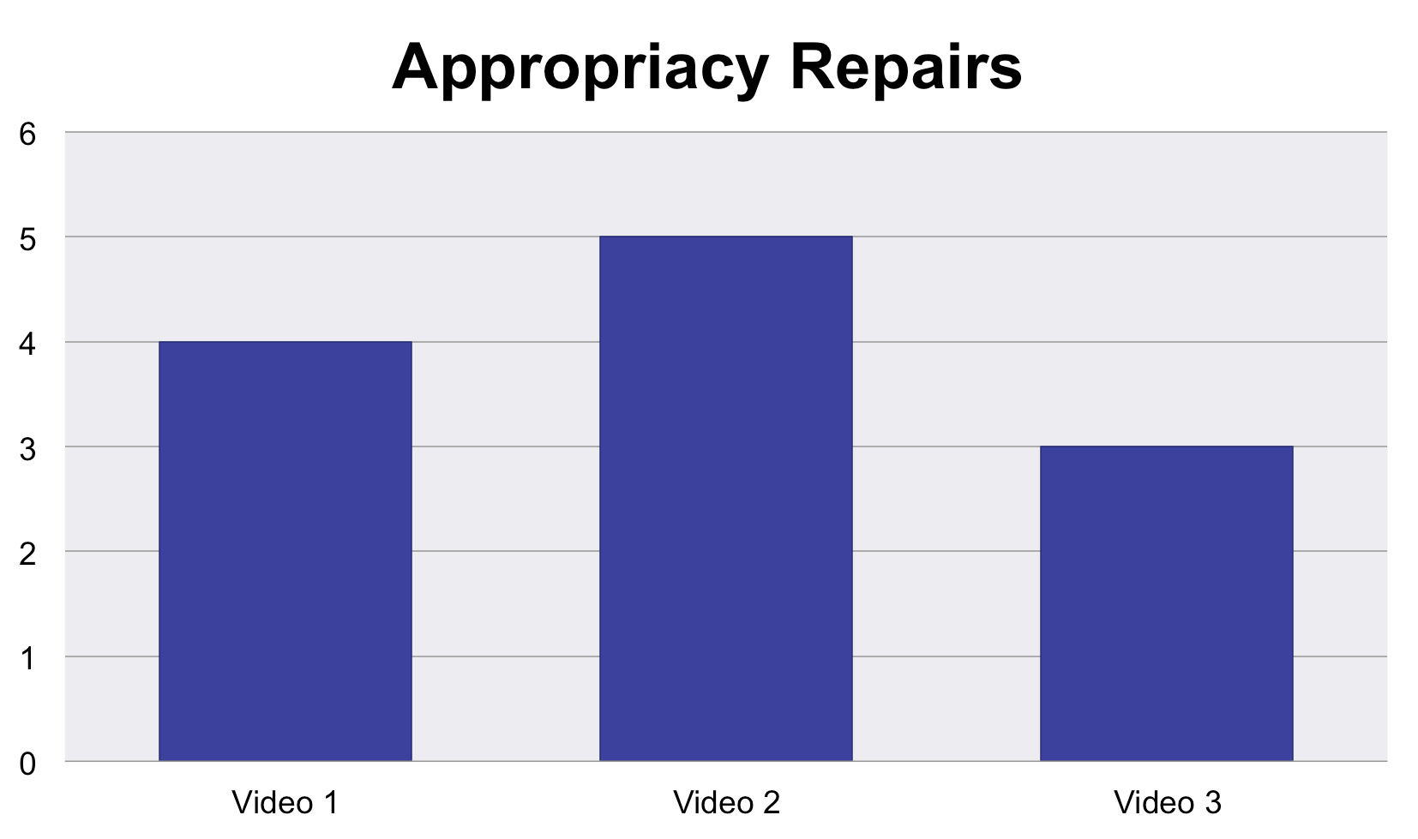
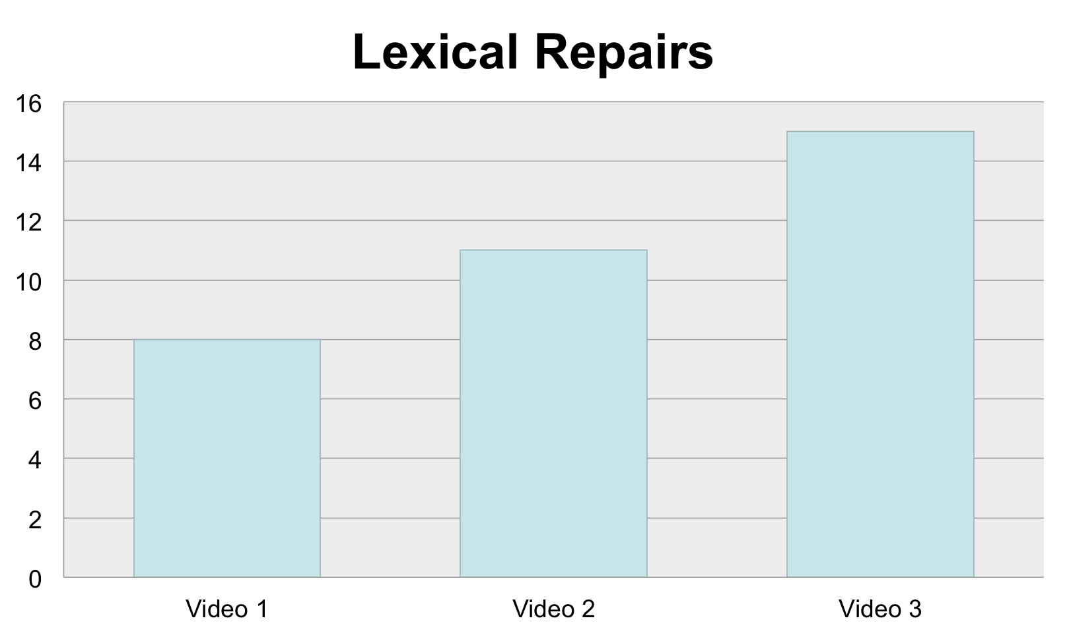
“An investigation of repairs and clarification strategies made during American Sign Language to English interpretation while interpreting in platform settings”
By Daisy Jo Robinson, INT492, Spring 2016
Introduction
Ø Each interpretation will facilitate in areas of corrections, repairs, and clarification, due to errors and mistakes that occur repairs or clarification strategies will occur.
Literature Review
Findings & Analysis
Discussion & Conclusion
The results obtained from the three video samples show that interpreters tend to make the same types of repairs and clarification strategies while interpreting. It is important to understand that the repairs and clarification strategies are similar because:
Ø It allows interpreters to know “they are not the only one” who are conducting the same types of strategies either intentionally or unintentionally.
Ø It allows consumers to
Methodology
Each data sample was analyzed two different times: no notes but observations, then recording the number of repairs and clarification strategies that occurred by following the categories of repairs explained by Kormo (2000): appropriacy repairs (lexical and insertion), error repairs (lexical, syntactic and phonological), and rectifying repairs (message abandonment).
Video Samples
Derived from Kormo’s (2000) research defining different meanings of repairs and clarification strategies.
 Message Abandonment: The
incomplete message is dropped as the speaker abandons the original message in order to formulate a new, different message.
 Error Repairs: The speaker repairs
an accidental lapse: such laps can occur at every phase of language
processing, that is, during accessing
lexical items, grammatical and phonological encoding, and articulation.
 Appropriacy Repairs: A speaker
decides to encode the originally intended information but a modified
way in order to make the message more clear or precise.
 Lexical Repairs: The repetition of a
Used from Gallaudet University Regional Interpreter Education Center (GURIEC)
 “Deaf Children’s Comprehension of Direct and Interpreted Education” presented by Kim B. Kurz, Ph.D. (2014)
 “Are Some ASL Lexical Signs 1000 Years Old?” presented by Keith M.
Caglel, Ph.D. (2015)
 “Interpreting Pragmatics: Insights from
Deaf Interpreter’s Target Language Focused Renderings” presented by
Christopher Stone, Ph.D. (2012)
understand and trust that their interpreters will be able to repair and clarify their interpreting processes when needed.
Ø It allows students and educators to analyze other interpreters and themselves through understanding their different types of techniques for repairs and clarification strategies.
References:
Cagle, K. M. (2015). Are Some ASL Lexical Signs 1000 Years Old? Gallaudet University Regional Interpreter Education Center. Youtube. https://www.youtube.com/watch?v=qlYvdQLMrGY&feature=youtu.be&t=21m16s
Kormos, J. (2000). The Role Of Attention In Monitoring Second Language Speech Production.
Language Learning 50.2, 343-384. Retrieved from: http://www.apa.org/pubs/databases/psycinfo/index.aspx
previous phrase or sentence with one or more words is inserted to clarify the original message or to make the message more precise.
Kurz, K. B. (2014). Deaf Children’s Comprehension of Direct and Interpreted Education.
Gallaudet University Regional Interpreter Education Center. Youtube. https://www.youtube.com/watch?v=_qh2qBofrzU&feature=youtu.be
Stone, C. (2012). Interpreting Pragmatics: Insights from Deaf Interpreter’s Target Language
Focused Renderings. Gallaudet University Regional Interpreter Education Center. YouTube. https://www.youtube.com/watch?v=y2qHuKvVPKs

