Slide 1
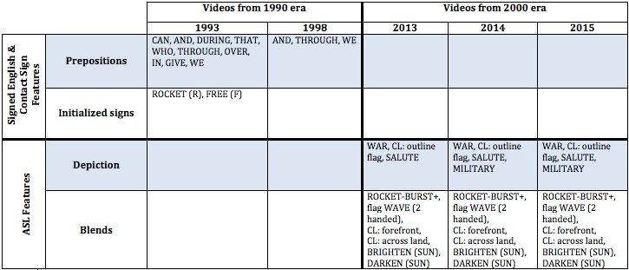
Examining ASL interpretations of the National Anthem: how have the interpretations changed from the 1990’s to now?
By Devon Lyons
Introduction
This research focuses on the comparison of five different ASL interpretations of the National Anthem from the Super Bowl. The years of the performances include: Super Bowl XXVII (1993), XXXIII (1998), XLVII (2013), XLVIII (2014) and XLIX
(2015). A closer look was taken at how the ASL interpretation of the National Anthem has changed over the years.
Traditionally, a frozen text like the National Anthem “is the same each time it is rendered” (Alcorn & Humphrey, p.17). Since ASL does not have a written form (Alcorn & Humphrey, p.190), it could be a contributing factor to the lack of standardization in the interpretation of the National Anthem. Therefore, the performances of the National Anthem in ASL vary much more than the version that it sung.
Methodology
Dividing the five videos into two eras, the 1990’s and the 2000’s. By choosing a couple videos from each era, the language features that were unique to it’s era would be made more prominent. To begin the search for the videos, different combinations of the key words: “ASL”, “interpretation”, “Super Bowl + (year)” in YouTube were used. When the five videos were analyzed, the lyrics of the National Anthem were typed out along with the ASL gloss of each interpretation.
The lyrics and ASL gloss were printed with a color coding system to identify similarities in each era. Thus, configuring a table to display the results (below).
Recommendations for further research
Looking at a larger number of ASL interpretations may provide stronger evidence of results.
Interviews with the interpreters could provide more insight as to why they made the sign choices they did.
A researcher with more knowledge of ASL linguistics can better identify ASL features and conclude more valid results.
Results
Conclusion
This research showed plausibility that the 1990’s era incorporated more Signed English and Contact Sign features while the 2000’s era used more ASL features. It seems as though the National Anthem interpretations from the 2000’s era incorporated more ASL features: depiction and blends.
Literature Review
Alcorn and Humphrey go into great detail about frozen texts: what settings they typically come up in, the vocabulary and sentence structure, turn-taking rules, rate and volume, and common speaker goals. (p. 17-19)
References
Alcorn, B., Humphries, J. (2007). So You Want to be An Interpreter? An Introduction to Sign Language Interpreting, (4th Ed.). p.17-19, 95, 190. Seattle, WA: H & H Publishing Co.
Signed English incorporates “all prepositions, conjunctions, prefixes, suffixes, and verb forms, following the structure of English rather than ASL” (Alcorn & Humphrey, p.95).
Edmond, T. (2015). Treshelle Edmond Super Bowl 2015 National Anthem with John Legend. Retrieved from: https://www.youtube.com/watch?v=M6iyLwOdi7w
Contact sign incorporates similar linguistic features such as: “English word order, the use of prepositions, constructions with that, English expressions, and mouthing of English words, as well as ASL nonmanual signals, body and eye gaze,
Flag Watermark Retrieved from: http://www.franciscanmissionaries.com/current-event/election- prayer-2/attachment/waving-american-flag-graphics-4-1/
and ASL use of space” (Valli et al, p. 193).
Discussion
Kramertony. (2015). Superbowl 27 - Anthem - Garth Brooks - (flyover). Retrieved from: https://www.youtube.com/watch?v=_0xAlYYZni4
Depiction is a feature in which signers use the whole upper body – hands, arms, face, etc. – to represent people’s actions (Valli et al, p.142).
The ASL interpretations from Super Bowl XXVII (1993) and XXXIII (1998) showed more evidence of Signed English and Contact Sign. Features such as prepositions (THAT and IN) and initialized signs (ROCKET (R) and FREE (F)) appeared in the 1990’s era but not in the 2000’s era.
There is a strong correlation between the three videos in the 2000 era and the use of ASL features. Interpretations from Super Bowl XLVII (2013), XLVIII (2014) and XLIX (2015) all used depiction when interpreting “thru the perilous fight,” signing WAR toward their bodies.
Blends were also used at other various times in the interpretations. One example would be ROCKET-BURST, this gave a more conceptual feel because the rocket would soar and then burst right away, the proper sequence of a rocket exploding. The signers blended the
handshape “1” while swirling up into “the sky” and then having it burst by ending in the “5” handshape.
NAD. (2013). Watch NAD: John Maucere Signs National Anthem. Retrieved from: https://www.youtube.com/watch?v=F0Yi_0DOgHE
“One way to describe how the form of depicting verbs represents aspects of their meaning through blending” (Liddell 2003a, Valli et al, p.138). ASL users take advantage of conceptual blending by using the fingers, hands, arms body, and face as the real “objects” representing scenes (Valli et al, p.139).
SSK1558. (2007). National Anthem. Retrieved from: https://www.youtube.com/watch?v=NJgWT8NMPJs
Valli, C., Lucas, C., Mulrooney, K., & Villanueva, M. (2011). Linguistics of American Sign Language: An Introduction (5th ed.). p.138, 142, 193. Washington, DC: Gallaudet University Press.
Wanger, K. (2014). Super Bowl XLVIII - National Anthem with ASL. Retrieved from: https://www.youtube.com/watch?v=snpsG7jmUGM

